Slide 1



VIVEKANANDA INSTITUTE OF TECHNOLOGY & SCIENCE
DEPARTMENT OF COMPUTER SCIENCE & ENGINEERING
TECHNICAL SEMINAR PRESENTATION ON
Federated Learning
PRESENTED BY
NAME : MOHAMMAD KHALID
HT.NO: 21N61A0546
4-1 CSE
01

Slide 2


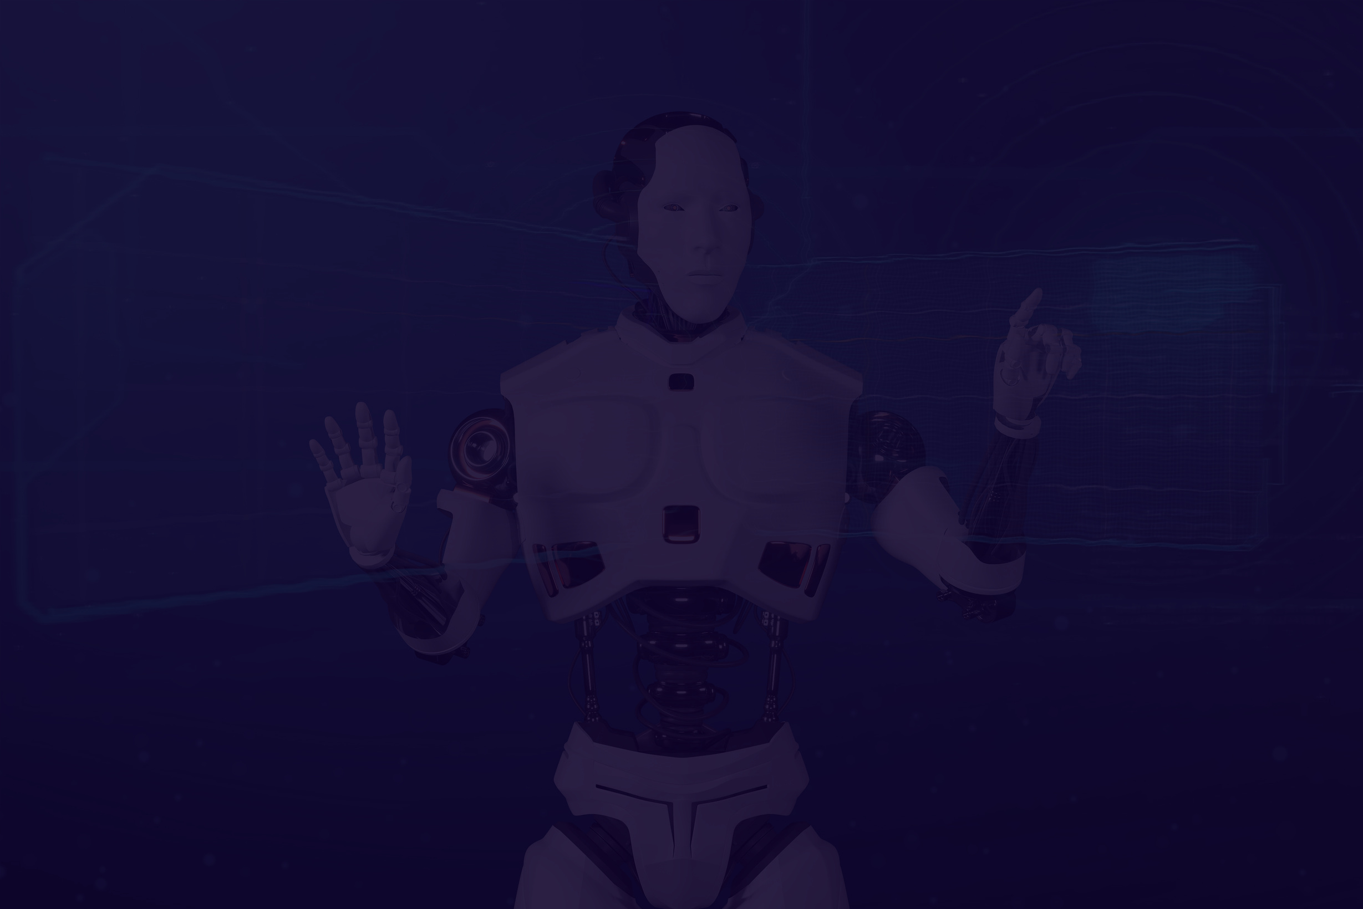
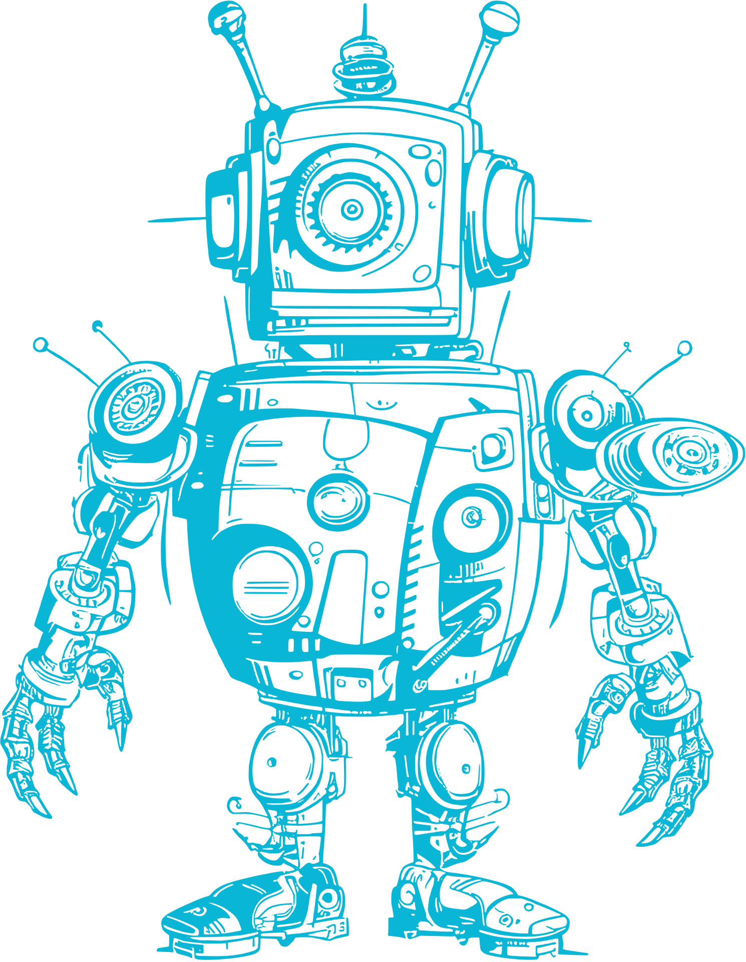

02
Welcome to Federated Learning!
Let’s dive into a new way of training AI models without data ever leaving your device!
02

Slide 3



What Is It, Really
Federated Learning is like a group project, but instead of sharing raw data, everyone only shares the final answer or insights they get.
It’s like cooking your favorite dish, but you don’t share the recipe, only the taste results!
03

Slide 4




04
Behind the Scenes: How It Works
Each device trains the model with its own local data. Instead of sending that data to the cloud, it sends the model update (like what it learned) to a central server. The central server aggregates these updates to create a more accurate model.

Slide 5




05
Real-Life Example: Google’s Keyboard
Federated Learning is used in Google’s Gboard keyboard. Your typing patterns are used to improve auto-correct and suggestions, but your actual text data never leaves your phone.
Khalid

Slide 6

06
Why Federated Learning?
In a world where data is currency, privacy is more important than ever. Federated Learning allows us to create smarter systems without compromising user privacy.
It’s like having a superpower without giving away your secret identity!
Khalid

Slide 7



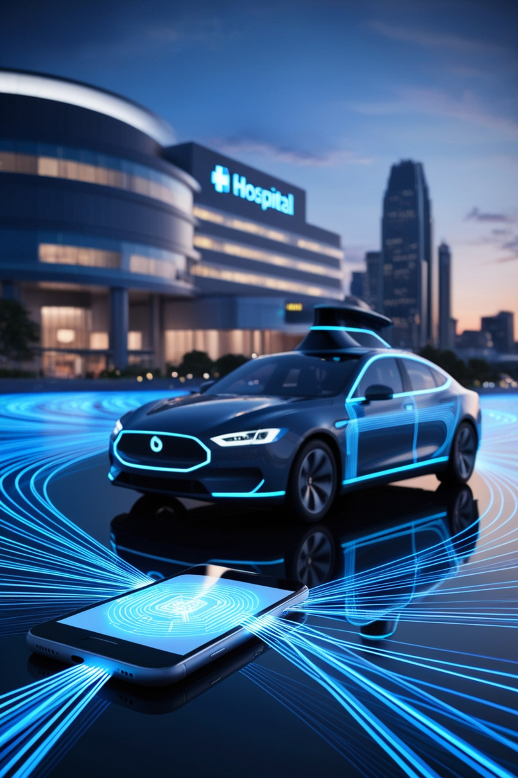
07
Where’s Federated Learning Being Used?
Beyond Gboard, it’s used in healthcare to create better predictive models without sharing sensitive patient data. Imagine doctors worldwide collaborating without ever sharing patient records!
Khalid

Slide 8





Challenges and Limitations
While it’s great, it’s not perfect. Communication costs, model accuracy, and even device compatibility can be big hurdles..
08

Slide 9

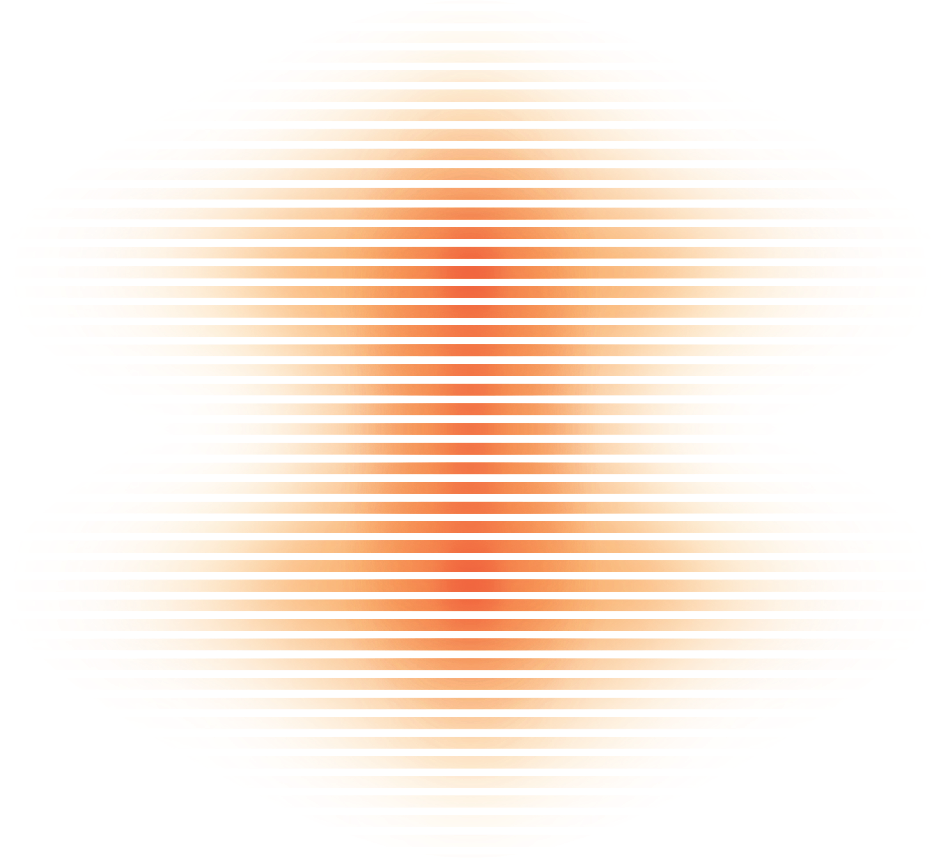

Challenges and Limitations
Communication Overhead
System Heterogeneity
Privacy and Security
Statistical Efficiency
System Complexity
09

Slide 10




10
Methodology
Data Privacy
Decentralized Model Training
Iterative Process
user data remains on local devices and isn't shared with central servers
A global model is initially distributed to all participating devices.
The central server continuously sends the improved global model back to the devices for further local training.

Slide 11


11
The Future:
What’s Next for Federated Learning?
As IoT and edge computing grow, federated learning is set to become a game-changer for industries like healthcare, finance, and smart cities.

Slide 12

LET’S BRAINSTORM TOGETHER
If you were a developer, where would you implement Federated Learning? Let’s hear your thoughts!

Slide 13
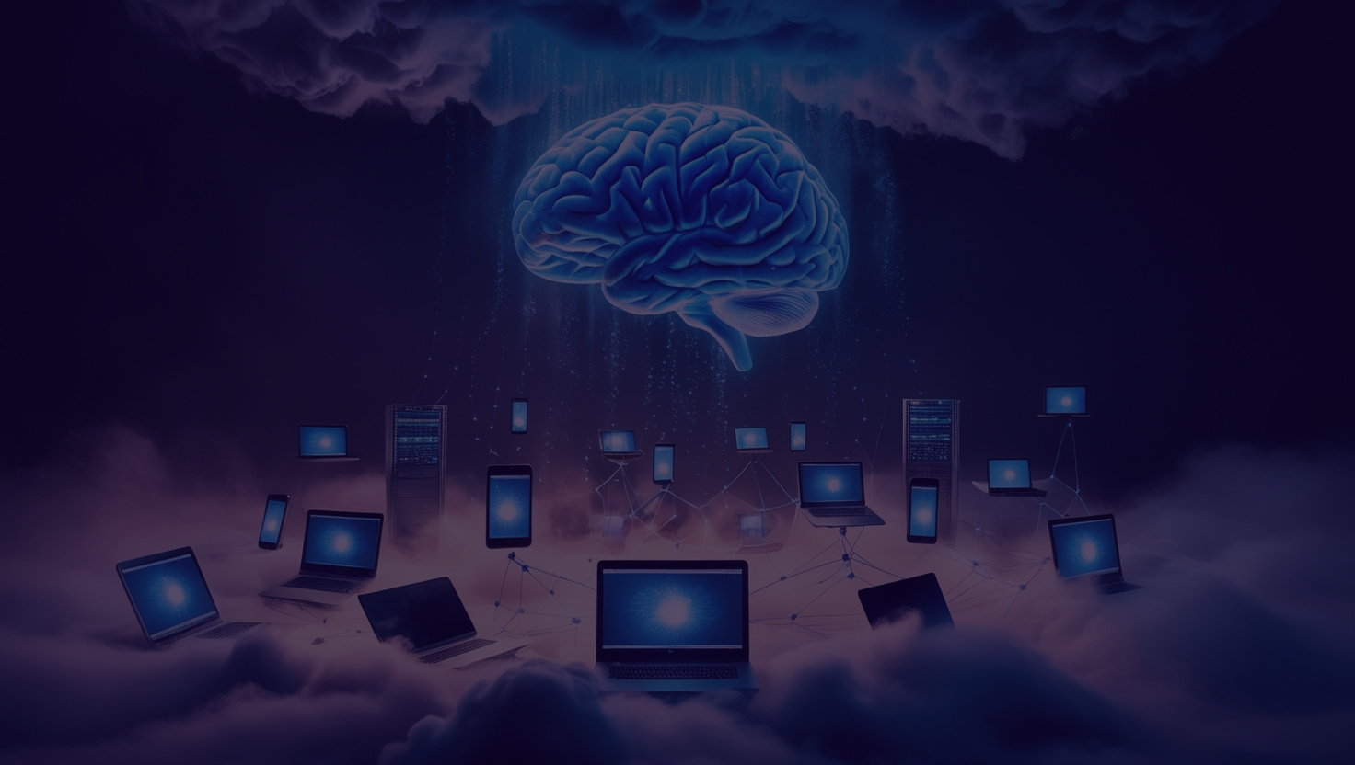
Federated Learning:
The Future of Smart and Secure AI
Federated Learning it build smarter systems while protecting user privacy. It’s like getting the best of both worlds—progress without the compromise.

Slide 14
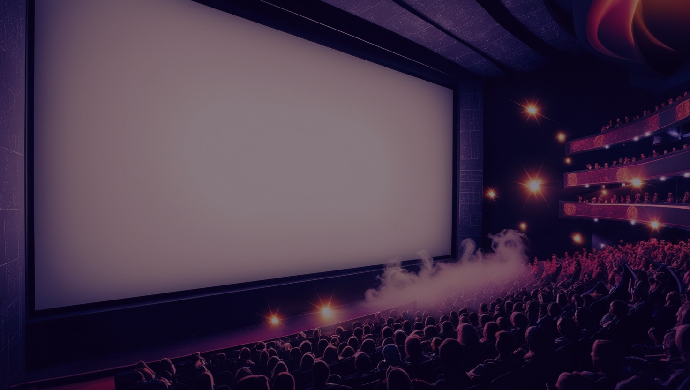
Thank You!
Thank You!
Thank You!
Khalid
Khalid
-

